Slide 1
Ping Pong Game
By:ANTIM Fulwere
Rajat Mandloi
Shubham Singh

Slide 2
About Game
A Pong game is table tennis based game and the goal is to repeatedly bounce a ball of your paddle until the other player fails to hit it .

Slide 3
Problem statement :
● Create a basic pong game using JavaScript where you can play with a computer.
● First to reach 10 points should win.
● Create different levels with increasing difficulty, like increasing ball speed, paddle becoming
smaller, etc.
● Add different obstacles in between the arena which deflect the ball at a new angle.
● Add moving obstacles which change the path of the ball.
● Leaderboard.
● PWA(Progressive web application).

Slide 4
Game flow :
Login Page .
Level selection (Easy , Medium , Hard).
Game Mode selection ( vs Computer or vs Player )
Game play.

Slide 5
Technologies used :
Javascript
Html , Bootstrap
CSS
Canvas element
Google firebase

Slide 6
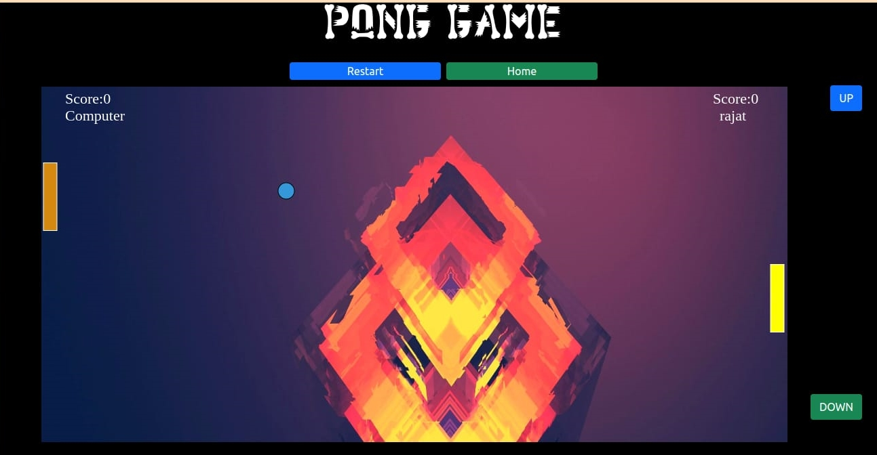
Game play: Easy level:-
Easy Level:

Slide 7
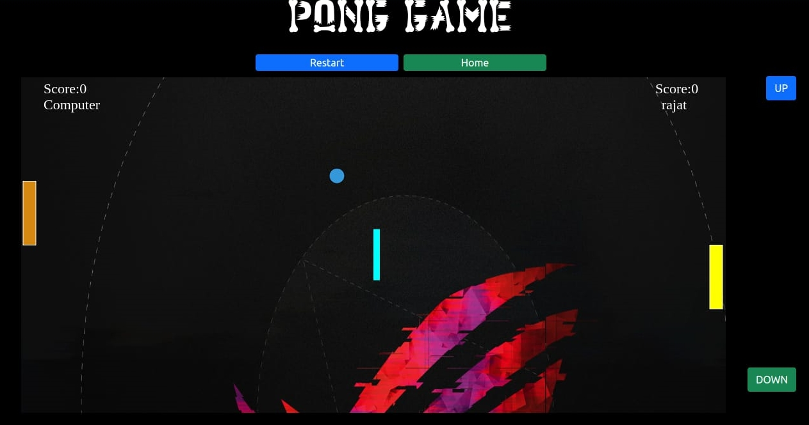
Medium level:

Slide 8
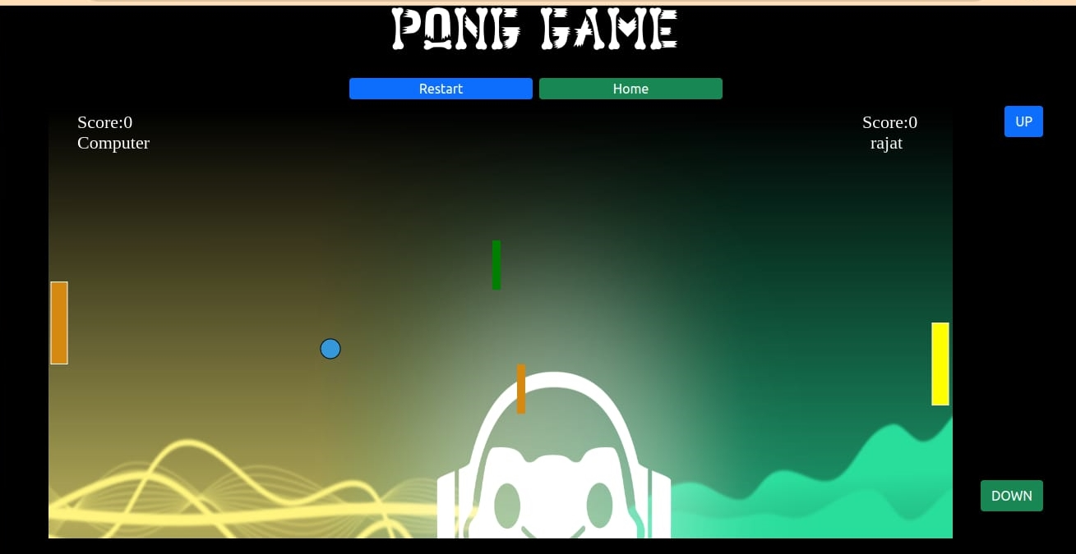
Hard level:

